Slide 1
Belmont High School Building Committee BHSBC
Community Update
October 13, 2017

Slide 2
Agenda
Project Update – Where Are We Going
District Enrollment Update
Grade Configuration Discussion
Results of Educational Visioning – Both Spring and Fall
Existing High School Conditions
Guiding Principles of Project Design
Design Space Summary
Making Decisions
Questions and Comments

Slide 3
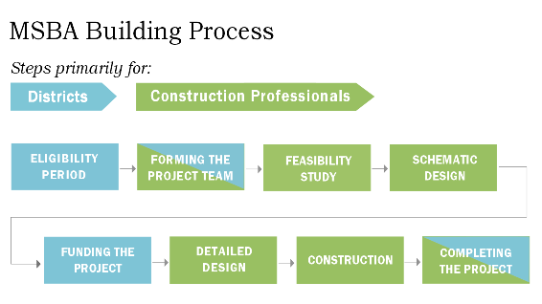
.
February 2016 Start
Completed July 2017
Present Stage
April 2018 Start
November 2018
or April 2019
Approx 12–15 Months
Approx 24-36 Months

Slide 5
BHSBC COMMUNITY ENGAGEMENT MEETINGS
Friday, October 13th – 1:15 PM, Beech Street Center
Saturday, October 28th – 10:00 AM, Belmont High School
Tuesday, December 12th – 7:00 PM, Belmont High School
January 2018 (date and location to be determined)

Slide 6
Two Lens to View the Work
Operations and Logistical Challenges / Opportunities
Increasing Enrollment and Limited Space
Educational Vision
What does the Belmont community believe is important in the future teaching and learning of its students
How do we construct a school around those educational values and characteristics

Slide 7
Enrollment – District Wide Increase over 6 Year Period & Projection over the next 2 Year Period
 | Oct. 1, 2011 | Oct. 1, 2012 | Oct. 1, 2013 | Oct. 1, 2014 | Oct. 1, 2015 | Oct. 1 2016 | Sept 1, 2017* | Oct. 1, 2019
BPS K-12 Enrollment | 3900 | 3994 | 4136 | 4222 | 4303 | 4408 | 4540* | 4705
 |  | 94 | 142 | 86 | 81 | 105 | 132*
 |  |  | Increase, 2011 to 2017 |  |  |  | 604
Given the average six year increase is 101 students per year our current projection of 4705 may be exceeded. * September 1 enrollment is an unofficial.

Slide 8
BHSBC/ MSBA: Grade Configurations
MSBA Configuration Options | Elementary | Middle School | Notes
9-12 * | K-4 | 5-8 | MS and Elementary enrollment / space issues not addressed.
8-12 * | K-4 | 5-7 | HS and MS levels would have space – Elementary level issues not addressed.
8/9…10-12
8… 9-12
7-12 * | K-3 | 4-6 | All levels would be provided space to accommodate increased enrollment.
7/8…9-12 7-9 … 10-12
* MSBA / BHSBC | Space Issues Still to be Resolved by Town

Slide 9
Belmont Public Schools Configurations Flow Chart

Slide 10
Decision and Roles on Configuration Options
BOS
BHSBC
Configuration Options
School Committee
MSBA

Slide 11
Belmont Public Schools
Initial Visioning Work with Frank Locker
in Spring of 2017
Two days of Educator Planning
One day of Educator Visioning
Two days of Community Members, Students and Educator Visioning

Slide 12
Key Words for Education
Educator and Community Workshop participants each identified one word or two-word phrases that best represented their individual thoughts about the future Educational Deliveries.
Their most commonly cited words are:
▪ Collaborative
▪ Authentic inquiry, inquiry-based, inquiry provocative
▪ Project based learning
▪ Integrated/interdisciplinary
▪ Evolving adaptable
▪ Engagement

Slide 13
KEY WORDS FOR FACILITIES As closure to the Educator Workshop, participants were asked to identify one word or a two-word phrase that best represented their personal thoughts about the future facilities.
Community Workshop participants were asked to do the same as a
summation challenge. Their words are:
Their most commonly cited key words are, in order of frequency are:
Elementary School
▪ Flexible, (space, chairs, teachers, etc)
Middle School
▪ Flexible, elastic/flexible, flexible spaces
High School
▪ Flexible, flexibility, flexible spaces, large flexible learning spaces, flexible grouping
▪ Bright open spaces
▪ Inspiring
▪ Flexible
▪ Fluid/open
▪ Inspiring

Slide 14
Visioning Session: Phase Two September 19 & 20, 2017
Feedback from Educators, Students and Community
Expert Presenters
Steve Turckes
K-12 Global Practice Leader
Perkins and Will A
Michael Horn
Reinventing Education
Chief Strategy Officer
David Dockterman
Education Use of Technology
Harvard School of Education

Slide 15
Visioning Session: Phase Two September 19 & 20, 2017
Visioning Outcomes
Feedback from Educators, Students and Community
Our design team “Perkins and Will” will incorporate the feedback and data from the recent 2 day session with the Frank Locker spring session findings.
The outcome of these sessions was to produce some initial Guiding Principles for the design team.
The feedback and the guiding principles will be utilized in the drafting of the Educational Program document that will be submitted to the MSBA.

Slide 16
Visioning Committees Grade Configuration Straw Poll
Visioning Session #1
Spring 2017
Visioning Session #2
Fall 2017
Participants identified preferred grade groupings in the next building:
Grade 9-12: 0 votes
Grade 8-12: 4 votes
Grade 7-12 school: 26 votes
Abstentions: 3
Participants identified preferred grade groupings in the next building:
Grade 9-12: 1 votes
Grade 8-12: 4 votes
Grade 7-12: 50 votes

Slide 17
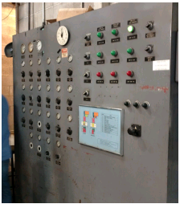
Existing High School Conditions

Slide 18
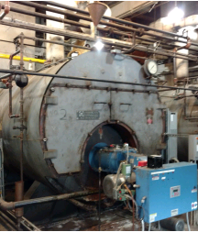
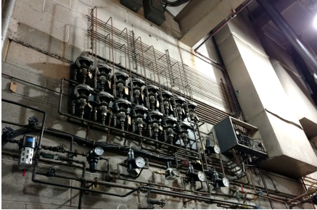
Existing High School Conditions

Slide 19
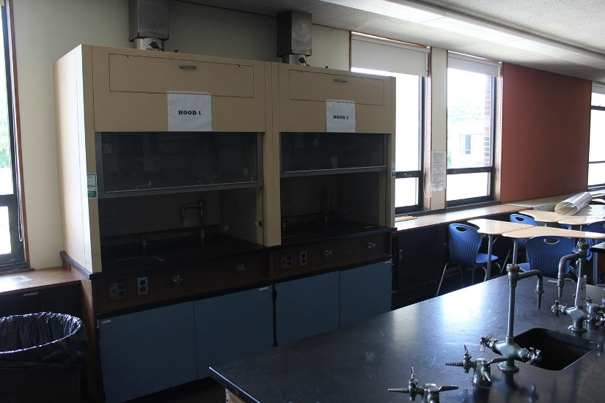
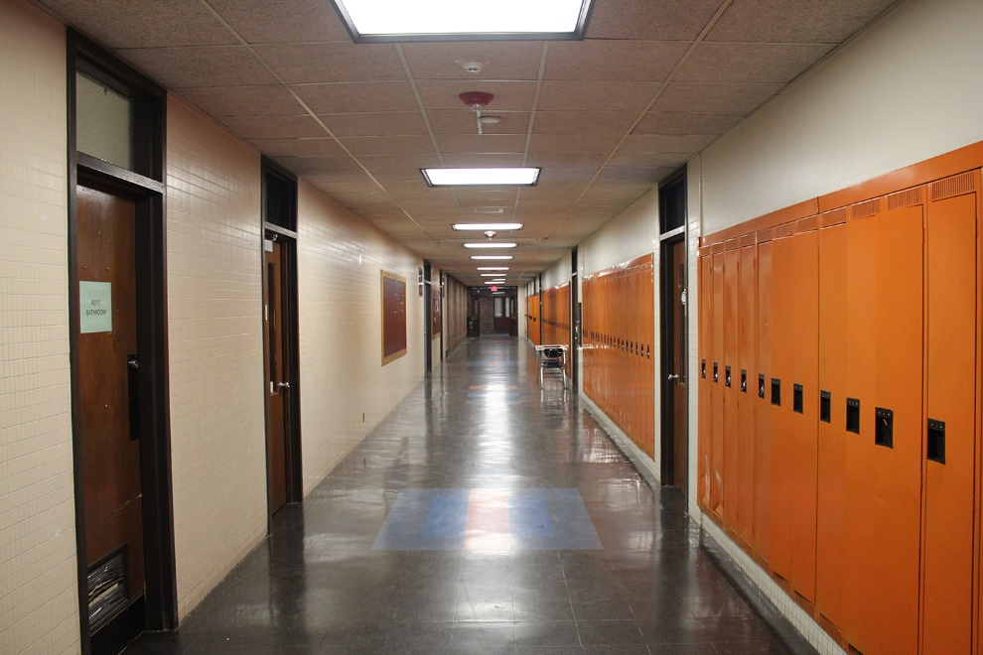
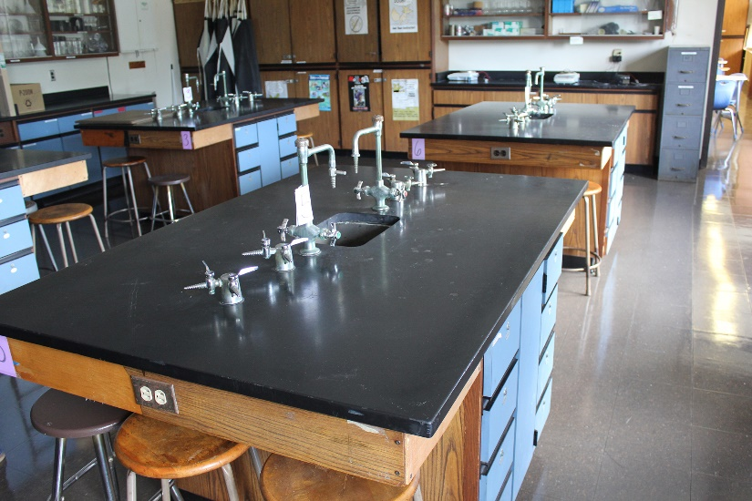
Existing High School Conditions

Slide 20
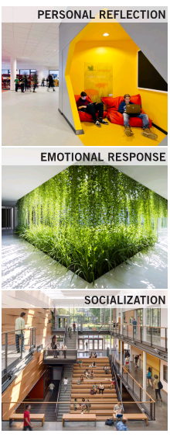
Guiding Principals of Project Design

Slide 21
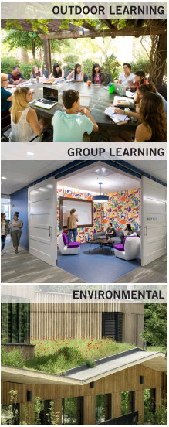
Guiding Principals of Project Design

Slide 22
Design Space Summary Estimate
Existing
255,000
sf
7-12
410,000
sf
8-12
355,000
sf
9-12
300,000
sf

Slide 23
Decision Tree

Slide 24
Belmont High School Building Committee BHSBC
Questions and Comments

