Slide 1


Design and Site Plan Review
Belmont Planning Board
Case 23-004
March 21, 2023

Slide 2
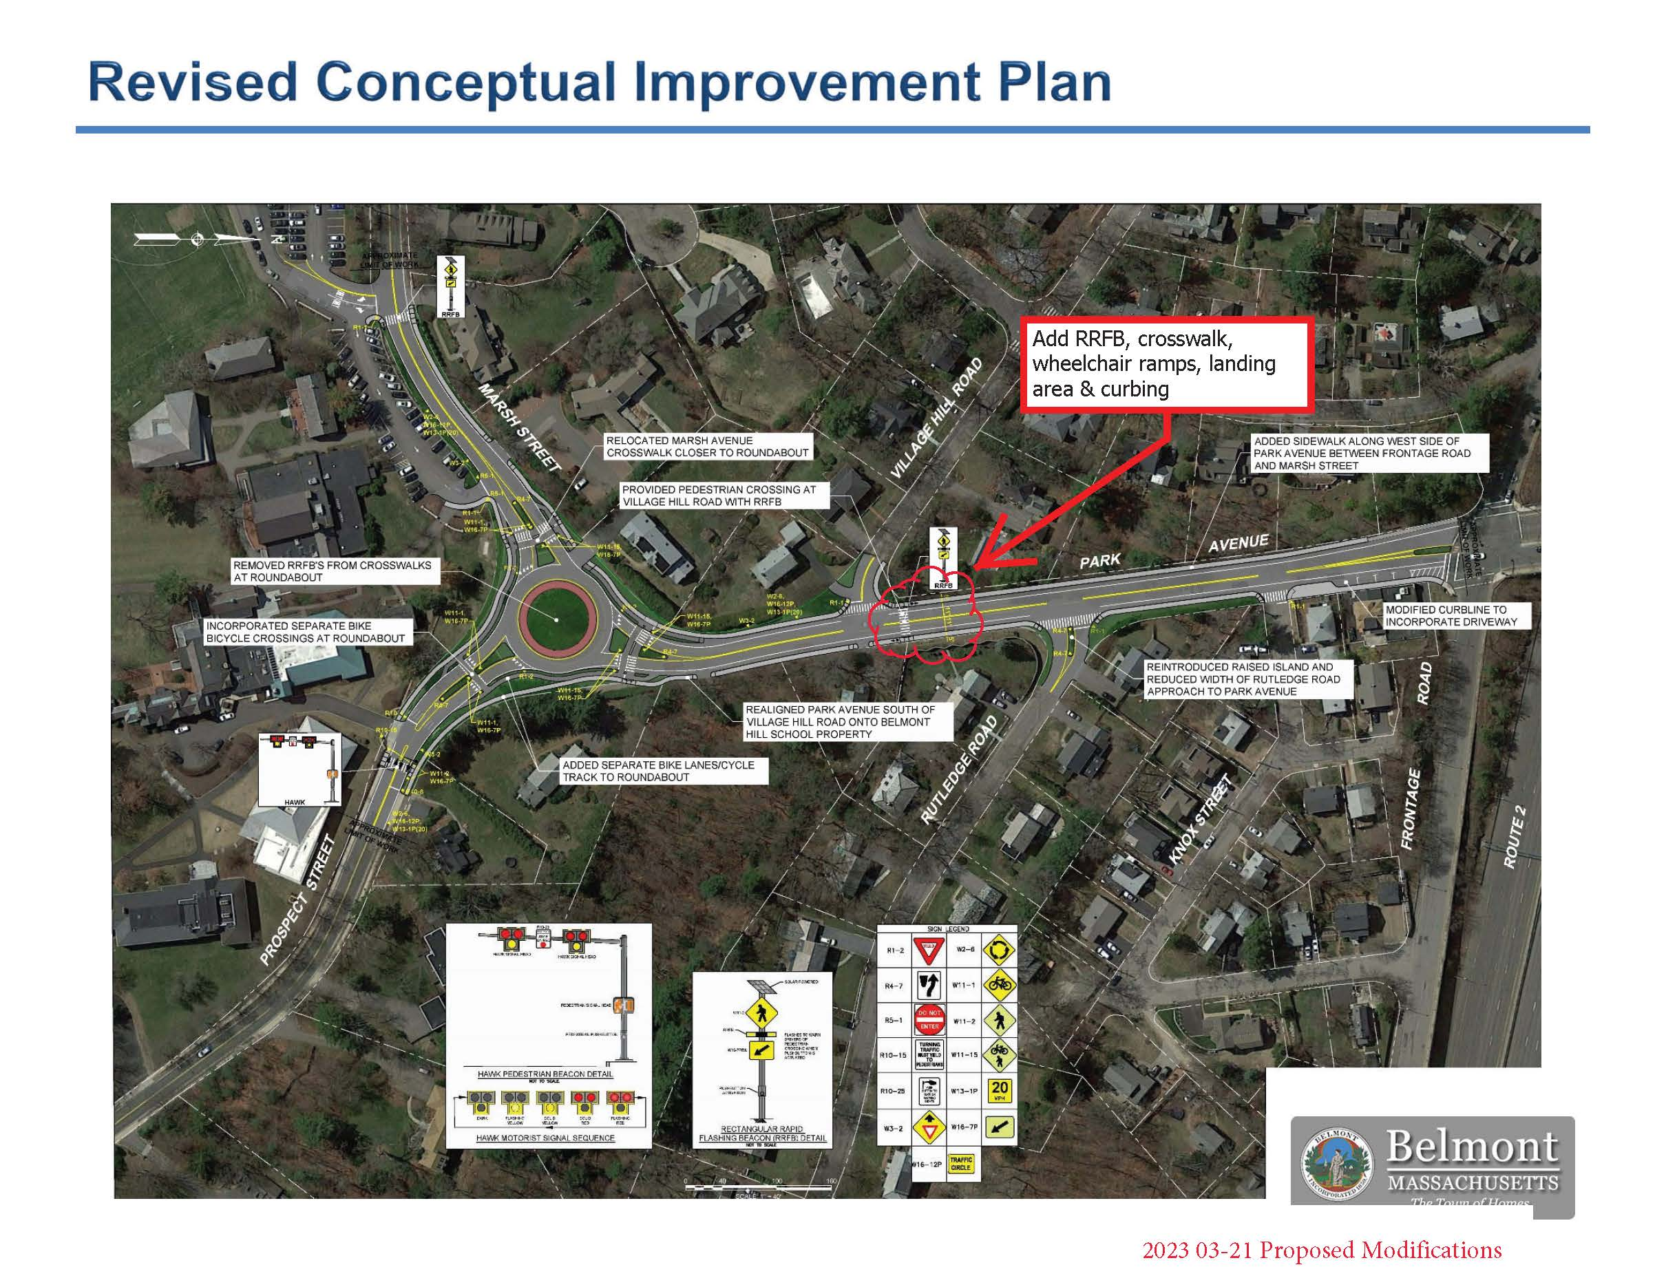

Proposed Cross Walk and RRFB

Slide 3
Proposed Cross Walk and RRFB

